Slide 1
Dependability and Security

Slide 2
System dependability
For many computer-based systems, the most important system property is the dependability of the system.
It reflects the extent of the user’s confidence that it will operate as users expect and that it will not ‘fail’ in normal use.
So, you can think of a dependable system as a system that does not fail.

Slide 3
Importance of dependability
System failures may have widespread effects with large numbers of people affected by the failure.
Systems that are not dependable and are unreliable, unsafe or insecure may be rejected by their users.
The costs of system failure may be very high if the failure leads to economic losses or physical damage.
Undependable systems may cause information loss with a high consequent recovery cost.

Slide 4
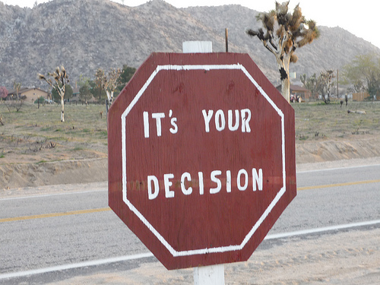
Dependability is subjective
The dependability of a system is not absolute but depends on the judgement of a system stakeholder. What seems to be a system failure to one stakeholder is normal behaviour to another.
The dependability of a system reflects the user’s degree of trust in that system.
Some people trust a system so don’t do backups
Others, backup obsessively

Slide 5
Dependability and specifications
Dependability can only be defined formally with respect to a system specification i.e. a failure is a deviation from a specification.
However, many specifications are incomplete or incorrect – hence, a system that conforms to its specification may ‘fail’ from the perspective of system users.
Furthermore, users don’t read specifications so don’t know how the system is supposed to behave.
Therefore perceived dependability is more important in practice.

Slide 6
Principal properties
Availability
The probability that the system will be up and running and able to deliver useful services to users.
Reliability
The probability that the system will correctly deliver services as expected by users.
Safety
A judgment of how likely it is that the system will cause damage to people or its environment.
Security
A judgment of how likely it is that the system can resist accidental or deliberate intrusions.

Slide 7
Dependability attribute dependencies
Safe system operation depends on the system being available and operating reliably.
A system may be unreliable because its data has been corrupted by an external attack.
Denial of service attacks on a system are intended to make it unavailable.
If a system is infected with a virus, you cannot be confident in its reliability or safety.

Slide 8
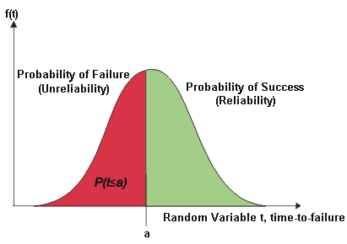
Availability and reliability
Reliability
The probability of failure-free system operation over a specified time in a given environment for a given purpose
Availability
The probability that a system, at a point in time, will be operational and able to deliver the requested services
Both reliability and availability attributes can be expressed quantitatively e.g. availability of 0.999 means that the system is up and running for 99.9% of the time.

Slide 9
Availability and reliability
Availability and reliability are closely related
Obviously if a system is unavailable it is not delivering the specified system services.
However, it is possible to have systems with low reliability that must be available.
So long as system failures can be repaired quickly and does not damage data, some system failures may not be a problem.
Availability is therefore best considered as a separate attribute reflecting whether or not the system can deliver its services.
Availability takes repair time into account, if the system has to be taken out of service to repair faults.

Slide 10
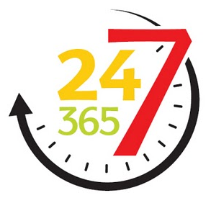
Availability perception
Availability is usually expressed as a percentage of the time that the system is available to deliver services e.g. 99.95%.
However, this ignores:
The number of users affected by the service outage. Loss of service in the middle of the night is less important for many systems than loss of service during peak usage periods.
The length of the outage. The longer the outage, the more the disruption. Several short outages are less likely to be disruptive than 1 long outage. Long repair times are a particular problem.

Slide 11
Reliability terminology
Term | Description
Human error or mistake | Human behavior that results in the introduction of faults into a system. For example, in the wilderness weather system, a programmer might decide that the way to compute the time for the next transmission is to add 1 hour to the current time. This works except when the transmission time is between 23.00 and midnight (midnight is 00.00 in the 24-hour clock).
System fault | A characteristic of a software system that can lead to a system error. The fault is the inclusion of the code to add 1 hour to the time of the last transmission, without a check if the time is greater than or equal to 23.00.
System error | An erroneous system state that can lead to system behavior that is unexpected by system users. The value of transmission time is set incorrectly (to 24.XX rather than 00.XX) when the faulty code is executed.
System failure | An event that occurs at some point in time when the system does not deliver a service as expected by its users. No weather data is transmitted because the time is invalid.

Slide 12
Faults and failures
Failures are a usually a result of system errors that are derived from faults in the system
However, faults do not necessarily result in system errors
The erroneous system state resulting from the fault may be transient and ‘corrected’ before an error arises.
The faulty code may never be executed.
Errors do not necessarily lead to system failures
The error can be corrected by built-in error detection and recovery
The failure can be protected against by built-in protection facilities. These may, for example, protect system resources from system errors

Slide 13
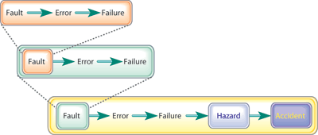
Faults-errors-failures

Slide 14
Reliability achievement
Fault avoidance
Development technique are used that either minimise the possibility of mistakes or trap mistakes before they result in the introduction of system faults.
Fault detection and removal
Verification and validation techniques that increase the probability of detecting and correcting errors before the system goes into service are used.
Fault tolerance
Run-time techniques are used to ensure that system faults do not result in system errors and/or that system errors do not lead to system failures.

Slide 15
Safety
Safety is a property of a system that reflects the system’s ability to operate, normally or abnormally, without danger of causing human injury or death and without damage to the system’s environment.
It is important to consider software safety as most devices whose failure is critical now incorporate software-based control systems.
Safety requirements are often exclusive requirements i.e. they exclude undesirable situations rather than specify required system services. These generate functional safety requirements.

Slide 16
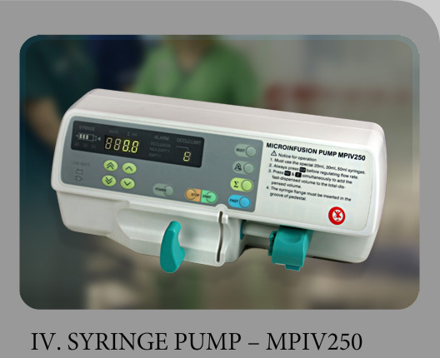
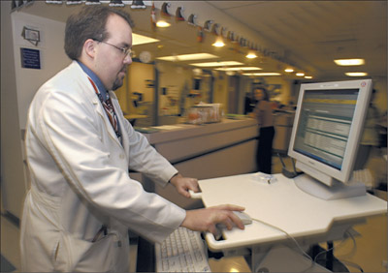
Safety criticality
Primary safety-critical systems
Embedded software systems whose failure can cause the associated hardware to fail and directly threaten people. Example is an insulin pump control system.
Secondary safety-critical systems
Systems whose failure results in faults in other (socio-technical) systems, which can then have safety consequences. For example, the MHC-PMS is safety-critical as failure may lead to inappropriate treatment being prescribed.

Slide 17
Safety and reliability
Safety and reliability are related but distinct
In general, reliability and availability are necessary but not sufficient conditions for system safety
Reliability is concerned with conformance to a given specification and delivery of service
Safety is concerned with ensuring system cannot cause damage irrespective of whether or not it conforms to its specification
A reliable system can be unsafe if the requirements are incorrect or incomplete

Slide 18
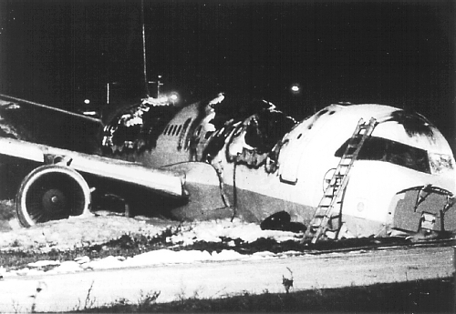
Unsafe reliable systems
The software on this plane operated ‘reliably’ yet the plane crashed due to a software-related problem

Slide 19
Unsafe reliable systems
There may be dormant faults in a system that are undetected for many years and only rarely arise.
Specification errors
If the system specification is incorrect then the system can behave as specified but still cause an accident.
Hardware failures generating spurious inputs
Hard to anticipate in the specification.
Context-sensitive commands i.e. issuing the right command at the wrong time
Often the result of operator error.

Slide 20
Safety terminology
Term | Definition
Accident (or mishap) | An unplanned event or sequence of events which results in human death or injury, damage to property, or to the environment. An overdose of insulin is an example of an accident.
Hazard | A condition with the potential for causing or contributing to an accident. A failure of the sensor that measures blood glucose is an example of a hazard.
Damage | A measure of the loss resulting from a mishap. Damage can range from many people being killed as a result of an accident to minor injury or property damage. Damage resulting from an overdose of insulin could be serious injury or the death of the user of the insulin pump.

Slide 21
Safety terminology
Term | Definition
Hazard severity | An assessment of the worst possible damage that could result from a particular hazard. Hazard severity can range from catastrophic, where many people are killed, to minor, where only minor damage results. When an individual death is a possibility, a reasonable assessment of hazard severity is ‘very high’.
Hazard probability | The probability of the events occurring which create a hazard. Probability values tend to be arbitrary but range from ‘probable’ (say 1/100 chance of a hazard occurring) to ‘implausible’ (no conceivable situations are likely in which the hazard could occur). The probability of a sensor failure in the insulin pump that results in an overdose is probably low.
Risk | This is a measure of the probability that the system will cause an accident. The risk is assessed by considering the hazard probability, the hazard severity, and the probability that the hazard will lead to an accident. The risk of an insulin overdose is probably medium to low.

Slide 22
Safety achievement
Hazard avoidance
The system is designed so that some classes of hazard simply cannot arise.
Hazard detection and removal
The system is designed so that hazards are detected and removed before they result in an accident.
Damage limitation
The system includes protection features that minimise the damage that may result from an accident.

Slide 23
Normal accidents
Accidents in complex systems rarely have a single cause as these systems are designed to be resilient to a single point of failure
Designing systems so that a single point of failure does not cause an accident is a fundamental principle of safe systems design.
Almost all accidents are a result of combinations of malfunctions rather than single failures.
It is probably the case that anticipating all problem combinations, especially, in software controlled systems is impossible so achieving complete safety is impossible. Accidents are inevitable.

Slide 24
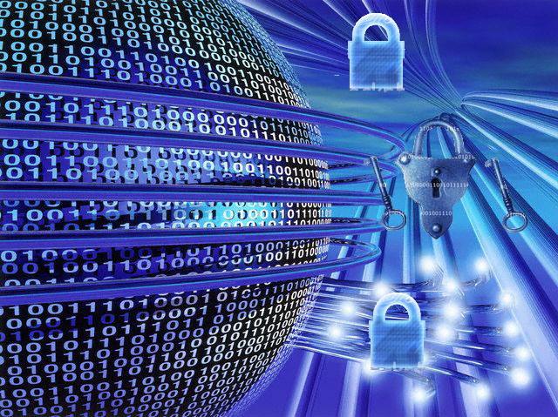
Security
The security of a system is a system property that reflects the system’s ability to protect itself from accidental or deliberate external attack.
Security is essential as most systems are networked so that external access to the system through the Internet is possible.
Security is essential for availability, reliability and safety.

Slide 25
Security terminology
Term | Definition
Asset | Something of value which has to be protected. The asset may be the software system itself or data used by that system.
Exposure | Possible loss or harm to a computing system. This can be loss or damage to data, or can be a loss of time and effort if recovery is necessary after a security breach.
Vulnerability | A weakness in a computer-based system that may be exploited to cause loss or harm.
Attack | An exploitation of a system’s vulnerability. Generally, this is from outside the system and is a deliberate attempt to cause some damage.
Threats | Circumstances that have potential to cause loss or harm. You can think of these as a system vulnerability that is subjected to an attack.
Control | A protective measure that reduces a system’s vulnerability. Encryption is an example of a control that reduces a vulnerability of a weak access control system

Slide 26
Examples of security terminology
Term | Example
Asset | The records of each patient that is receiving or has received treatment.
Exposure | Potential financial loss from future patients who do not seek treatment because they do not trust the clinic to maintain their data. Financial loss from legal action by the sports star. Loss of reputation.
Vulnerability | A weak password system which makes it easy for users to set guessable passwords. User ids that are the same as names.
Attack | An impersonation of an authorized user.
Threat | An unauthorized user will gain access to the system by guessing the credentials (login name and password) of an authorized user.
Control | A password checking system that disallows user passwords that are proper names or words that are normally included in a dictionary.

Slide 27
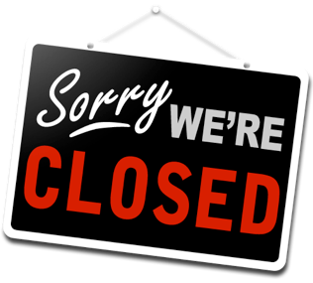
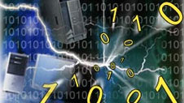
Damage from insecurity
Denial of service
The system is forced into a state where normal services are unavailable or where service provision is significantly degraded
Corruption of programs or data
The programs or data in the system may be modified in an unauthorised way
Disclosure of confidential information
Information that is managed by the system may be exposed to people who are not authorised to read or use that information

Slide 28
Security assurance
Vulnerability avoidance
The system is designed so that vulnerabilities do not occur. For example, if there is no external network connection then external attack is impossible
Attack detection and elimination
The system is designed so that attacks on vulnerabilities are detected and neutralised before they result in an exposure. For example, virus checkers find and remove viruses before they infect a system
Exposure limitation and recovery
The system is designed so that the adverse consequences of a successful attack are minimised. For example, a backup policy allows damaged information to be restored

Slide 29
Key points
Reliability is related to the probability of an error occurring in operational use. A system with known faults may be reliable.
Safety is a system attribute that reflects the system’s ability to operate without threatening people or the environment.
Security is a system attribute that reflects the system’s ability to protect itself from external attack.
Dependability is compromised if a system is insecure as the code or data may be corrupted.

